Slide 1

Sentiment Analysis of
Yelp Reviews using
NLP Techniques
Chenhao Shangguan
Kaiyu Zhang
Kun Bai
Yindi Ma
2021.12.03

Slide 2

1
2
3
Question of Interest
Dataset
Motivation
CONTENTS
4
5
6
Methods
Accuracy
Discussion

Slide 3



1
Motivation
Business Owners
Yelp
Understand customers' needs
Ratings
Reviews

Slide 4
2
Question of Interest
Will using NLP approach to implement the sentiment analysis in large-scale data provide an accurate prediction? (Accuracy > 0.5)

Slide 5
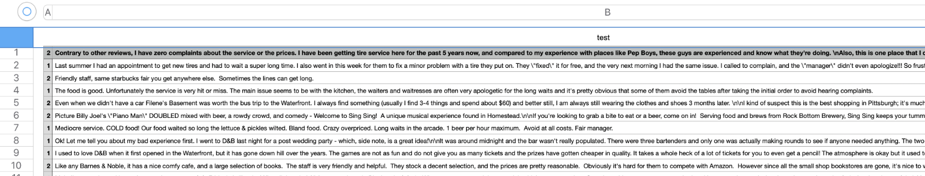
3
Dataset
The dataset contain 560,000 training samples and 38,000 testing samples of Yelp reviews.
Dataset Website: https://www.kaggle.com/ilhamfp31/yelp-review-dataset

Slide 6
4
Sentiment Analysis
A powerful tool enables business owners to understand emotions of customers in marketing campaigns
An important factor for business owners to check the products’ performance for strategy adjustment

Slide 7
6
Method
Programming language:
Python - Numpy, Scipy, Pandas being used
Libraries:
Numpy
Scipy
Pandas
nltk
sklearn

Slide 8
7
Analysis Procedure
Words Embedding
Word count;
TF-IDF (frequency/count):
high frequency/shrinkage
Preprocessing
2
1
Drop out stop words/lemmatization
in the same direction
METHOD
Classifier
3
4
Accuracy
Naive Bayes Classifier
SVM
Logistic Regression
Compute and compare the accuracy
with three classifiers

Slide 9
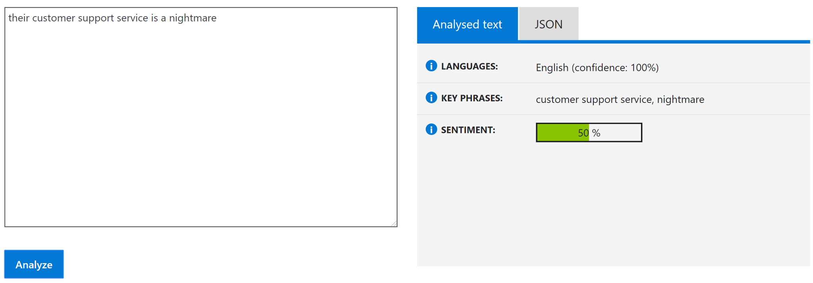
7
Preprocessing
Azure text analytics API results as of publication date (30 Aug 2019)

Slide 10
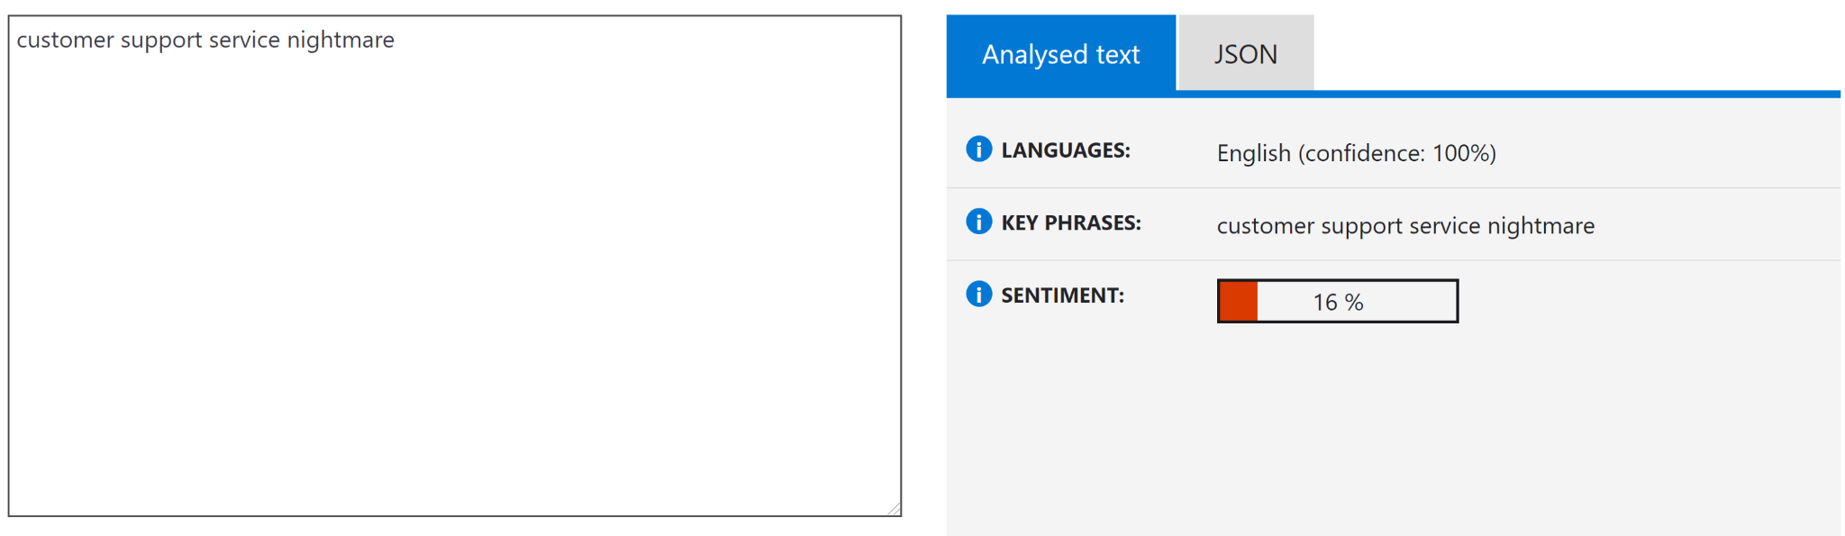
7
Preprocessing
Azure text analytics API results after preprocessing
Delete: their, is, a

Slide 11
7
Remove Stop Words
The words which are generally filtered out before processing a natural language are called stop words.
Examples of a few stop words in English are “the”, “a”, “an”, “so”, “what”.

Slide 12
7
Lemmatization
Process of Converting a word to its Base Form:
cared, caring, cares care
loved, loving, loves love
text = """he kept eating while we are talking"""
result: ['he', 'keep', 'eat', 'while', 'we', 'be', 'talk']

Slide 13
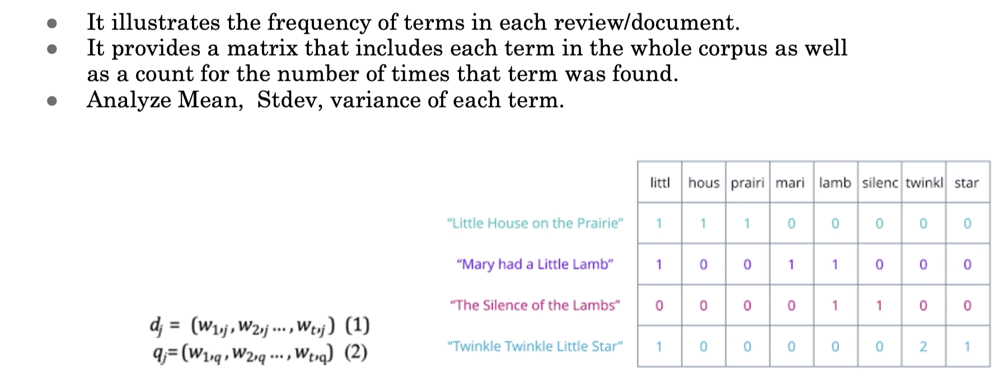
7
Word-embedding:Word Count

Slide 14
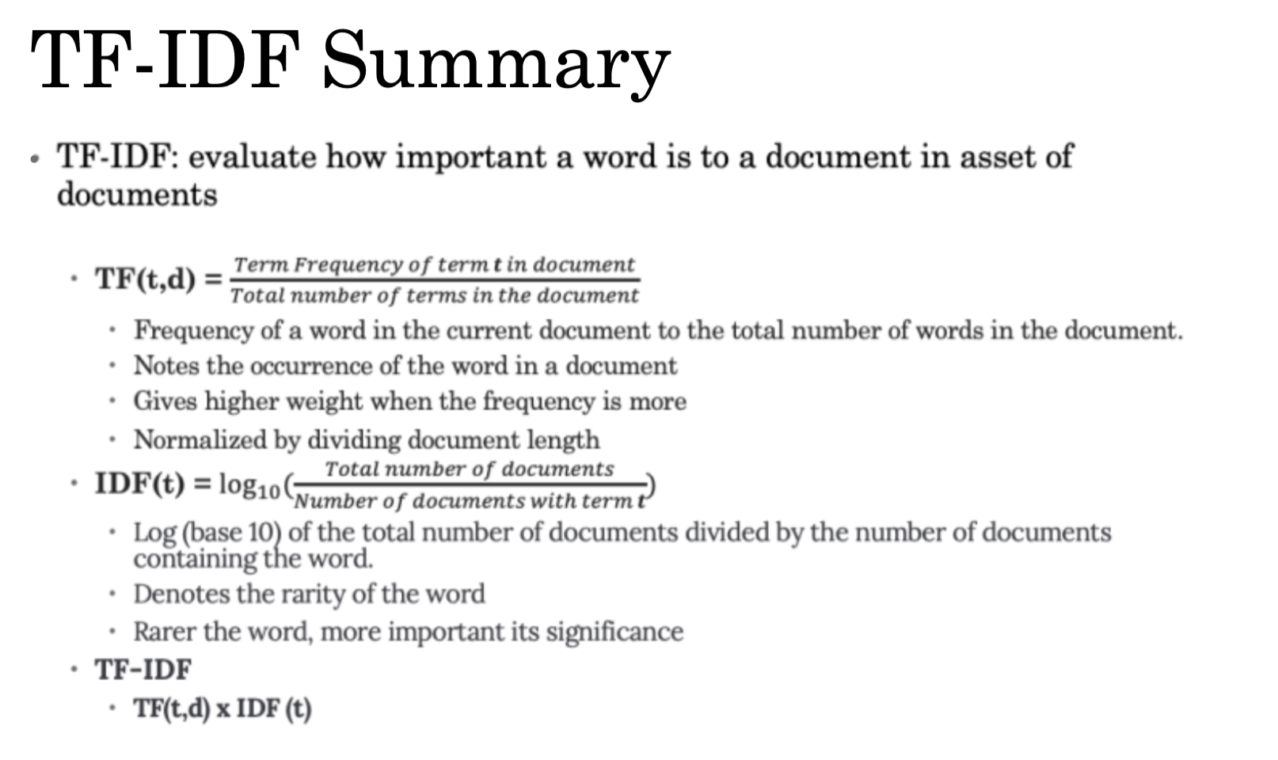
8
Word-embedding:TF-IDF

Slide 15
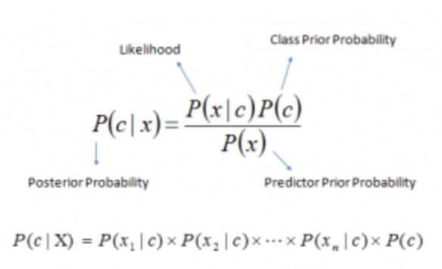
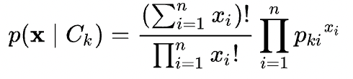
9
Classifying Methods
Multinomial Naive Bayes Classifier
In simple terms, a Naive Bayes classifier assumes that the presence of a particular feature in a class is unrelated to the presence of any other feature. (Naive)
Step 1:
Convert the data set into a frequency table
Step 2:
Create Likelihood table by finding the probabilities
Step 3:
Use Naive Bayesian equation to calculate the posterior probability for each class.
The class with the highest posterior probability is the outcome of prediction.
The likelihood of observing a histogram x is given by:

Slide 16

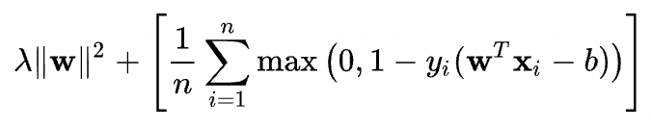
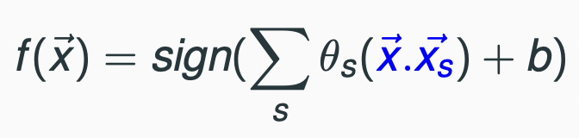
10
Classifying Methods
Support Vector Machine
SVMs are supervised algorithms for binary classification tasks
Support vectors are points in the data that lie closest to the classification hyperplane
Goal: Find the separating hyperplane by optimization and make decision to classify
Minimize (By training)
Classification (For testing)

Slide 17
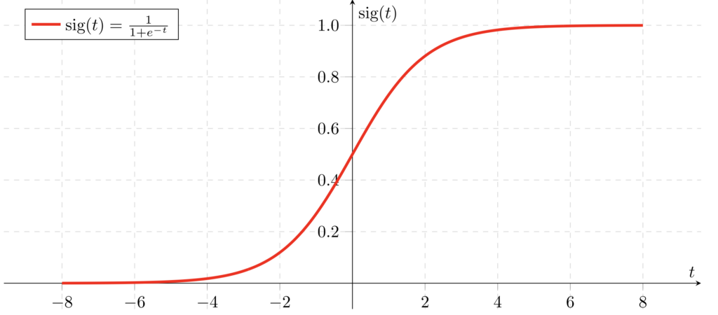
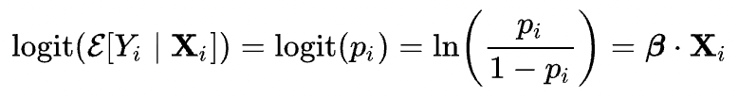
11
Classifying Methods
Logistic Regression
Logistic regression is a statistical machine learning algorithm that classifies the data by considering outcome variables on extreme ends and tries makes a logarithmic line that distinguishes between them.
This model creates a regression model to predict the likelihood that a given data entry belongs to the category labeled “1.”
Logistic regression models the data using the sigmoid function, much as linear regression assumes that the data follows a linear distribution.
A threshold can be established to forecast which class a data belongs to. The derived estimated probability is categorized into classes based on this threshold.
If the predicted value is less than 0.5, categorize the sentence into the negative group; otherwise, label it into the positive group.

Slide 18
13
Accuracy of Count-vectors
86.8%
93.1%
93.5%
Multinomial Naive Bayes Classifier
Support Vector Machine
Logistic Regression

Slide 19
12
Accuracy of TF-IDF-vectors
81.8%
85.8%
87.2%
Multinomial Naive Bayes Classifier
Support Vector Machine
Logistic Regression

Slide 20

14
Naive Bayes Classifier
Fastest but least accurate
Discussion
SVM
Better than Neural Network
Logistic Regression
Most accurate but lowest

Slide 21
15
References
https://encrypted-tbn0.gstatic.com/images?q=tbn:ANd9GcTVhvbyYdv1pVza3mwS3tM9S3lF8WyrIhJqYg&usqp=CAU

Slide 22
Thanks For Watching

